Slide 1

Carlton Knox Po Hao Chen Basil Ng

Slide 2
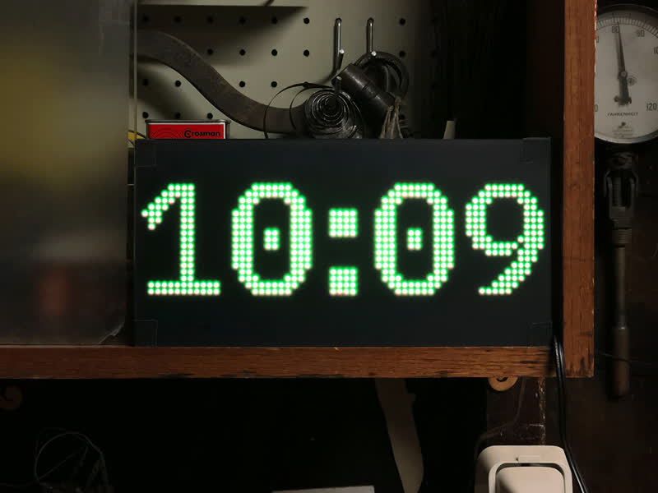
Goal / Motivation
Tetris the puzzle video game classic that we all know and love. The player stacks a sequence of “tetrominoes” into a 10x20 grid.
Goal: We set out to re-implement the game logic on a 32 x 64 matrix with support for multiplayer.
Motivation: this challenge to work with the LED matrix and to do something cool with it.
Applications: Our design can be easily adapted to other display, controllable by the user, such as a digital clock, and more.

Slide 3
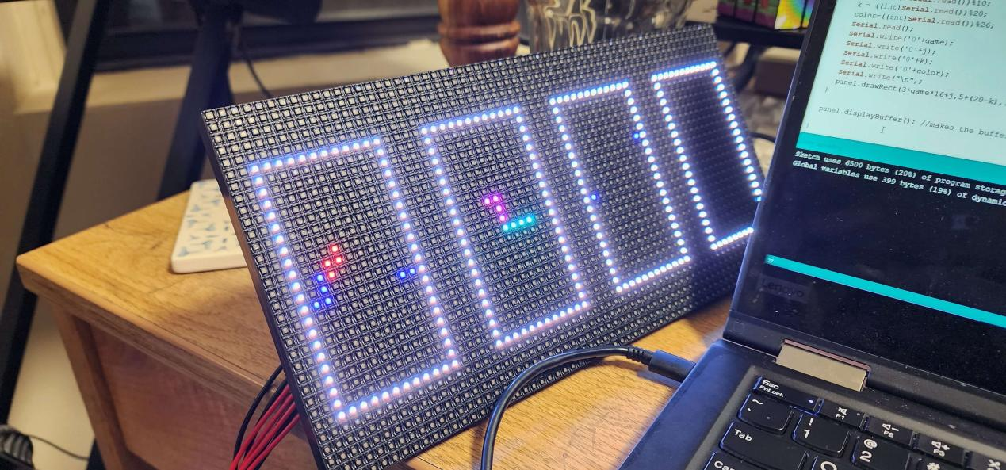
Short Functionality
>> Player controls the blocks via keyboard PS2 input
>> Input goes into the game logic
>> Tetris Game Logic
>> Falling Block FSMs (Carlton & Basil)
>> FPGA outputs Tetris graphics (Arduino/Matrix or VGA)
>> Game Ends When Fall Fails
( Po Hao & Basil & Carlton)
(Basil & Po Hao & Carlton)
(Carlton)
(Po Hao & Basil)

Slide 4
Short Specification
Reduce high clock frequency of falling blocks (11~12 ns delay),
Solution: Divide the clock to increase the allowed delay. (20 ns)
UART controller (Graphix_printer) (> 20ns)
Solution: Divide the clock twice to increase the allowed delay. (40 ns)

Slide 5
Detailed Functionality: Tetris FSM
S_INIT = 0, S_FALL = 1, S_SET = 2, S_BREAK = 3, S_OVER=4;
S_INIT: sets block at top of the screen
S_FALL: 1. falls block until it reaches the bottom (or a different block)
2. NO_INPUT = 4'b0000, RIGHT = 4'b0001, LEFT = 4'b1000, INSTA_FALL = 4'b0100, FAST_FALL = 4'b0010, ROTATE_RIGHT = 4'b0011, ROTATE_LEFT = 4'b1100;
S_SET: 1. once collision is detected, set the block in place
2. This state also checks if the block hits to top boundary (to S_OVER)
S_BREAK: shifts out all filled line, and replace to with zero on top
S_OVER: ends game

Slide 6
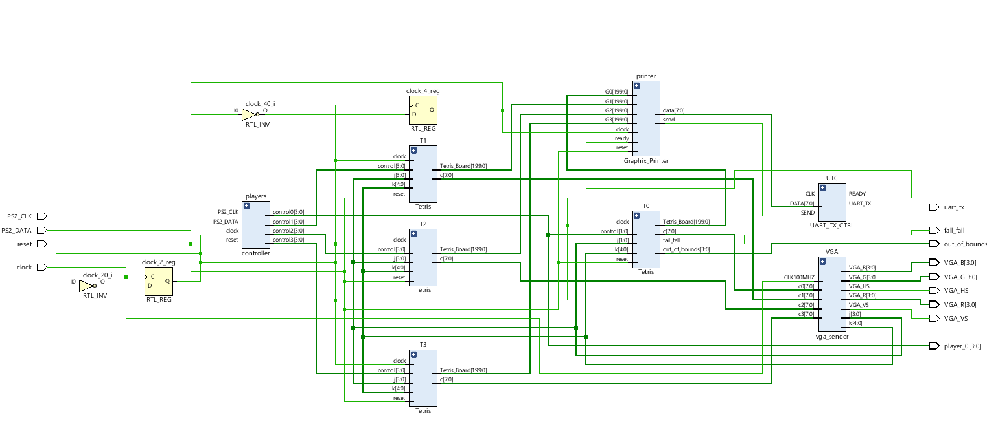
Top-level Block Diagram

Slide 7
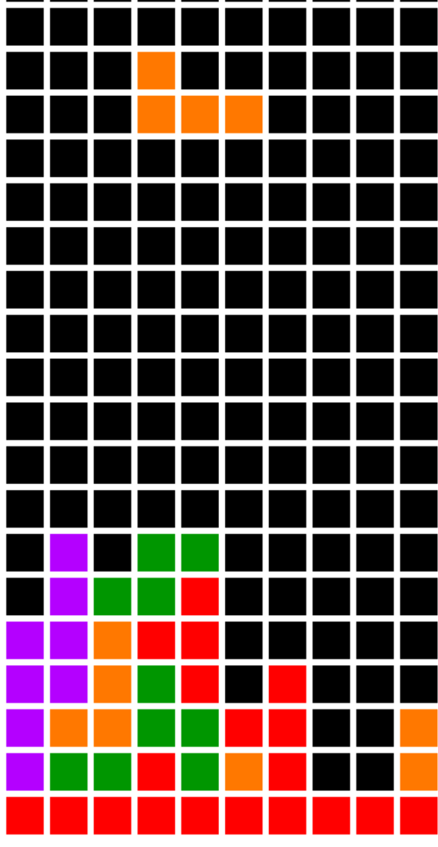
Tetris Block Diagram
Tetris
control
Based on input and current tetris state, update tetris board and FB inputs
control
If FB fails to fall, or out of bounds, set appropriate state (set/game over)
Falling Block
fall_fail
fall
Using tetronimo shapes, check for collisions and determine next FB state
out_of_bounds
Tetris Board
Next tetromino
Current tetromino

Slide 8
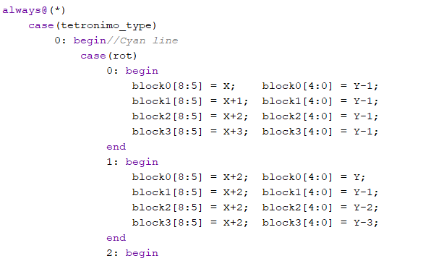
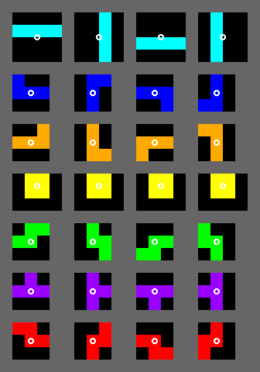
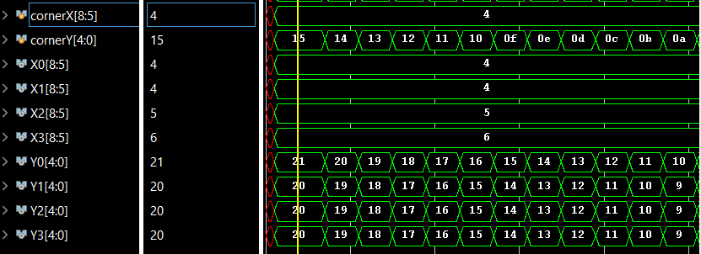
Tetromino
rot
0 1 2 3
Tetronimo_type
0
1
2
3
4
5
6

Slide 9
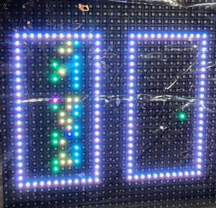
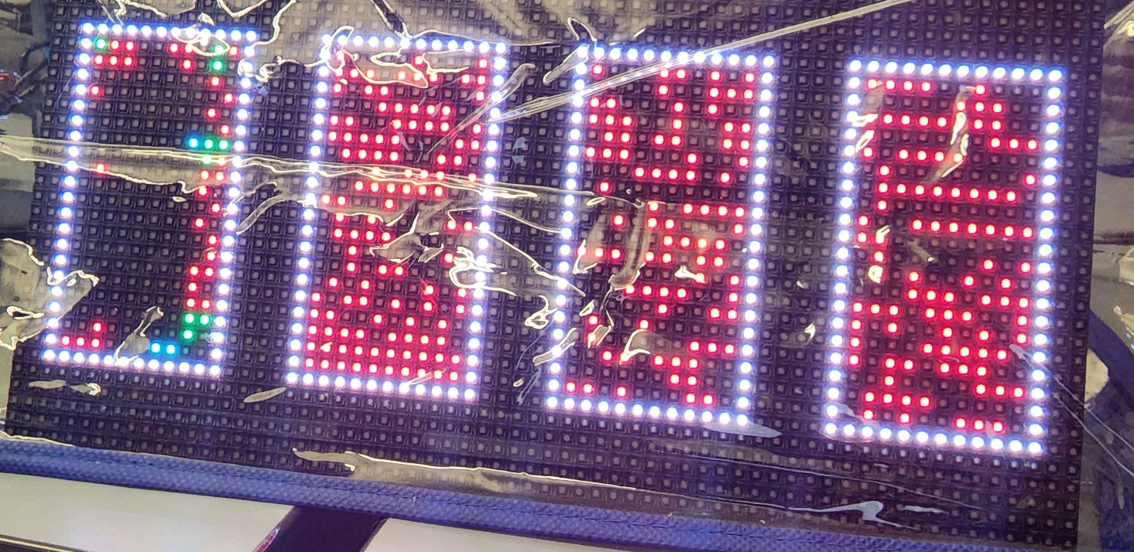
FPGA->UART->Arduino->RGB Matrix
Arduino
Receive 4 bytes via UART, corresponding to game, x,y, and color.
Program one pixel at a time
Graphix_printer module (FPGA)
State machine to print out one pixel at a time over UART
Original implementation: Send all 800 pixels each loop
too much data flooded serial bus
“Optimized” algorithm: only send pixels that need to be updated
Greatly reduced frequency of print,
However, resulted in some “trailing” and unprinted pixels

Slide 10
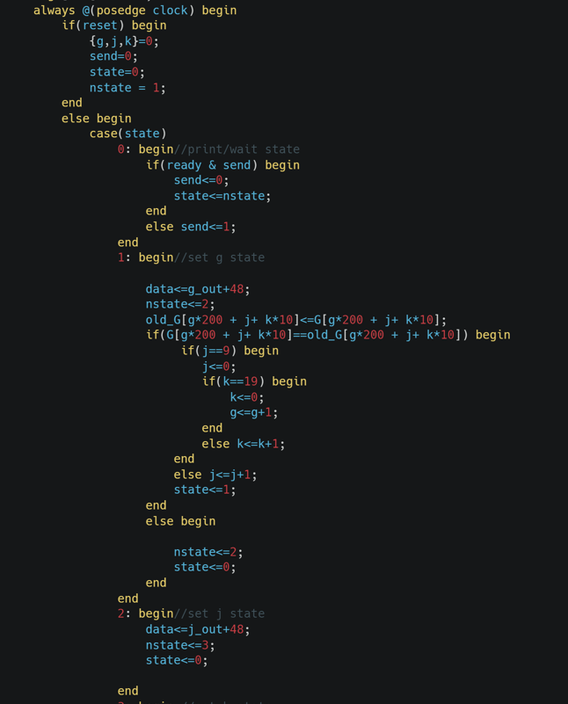
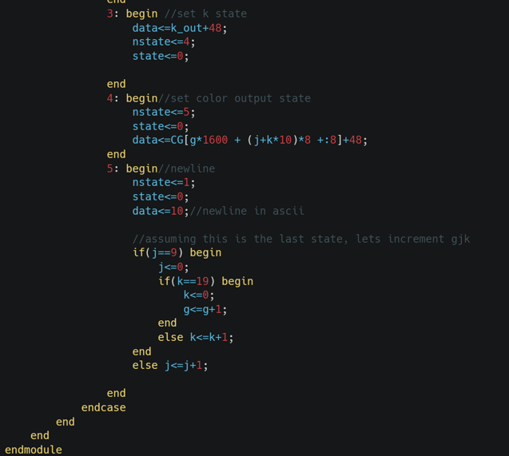

Slide 11
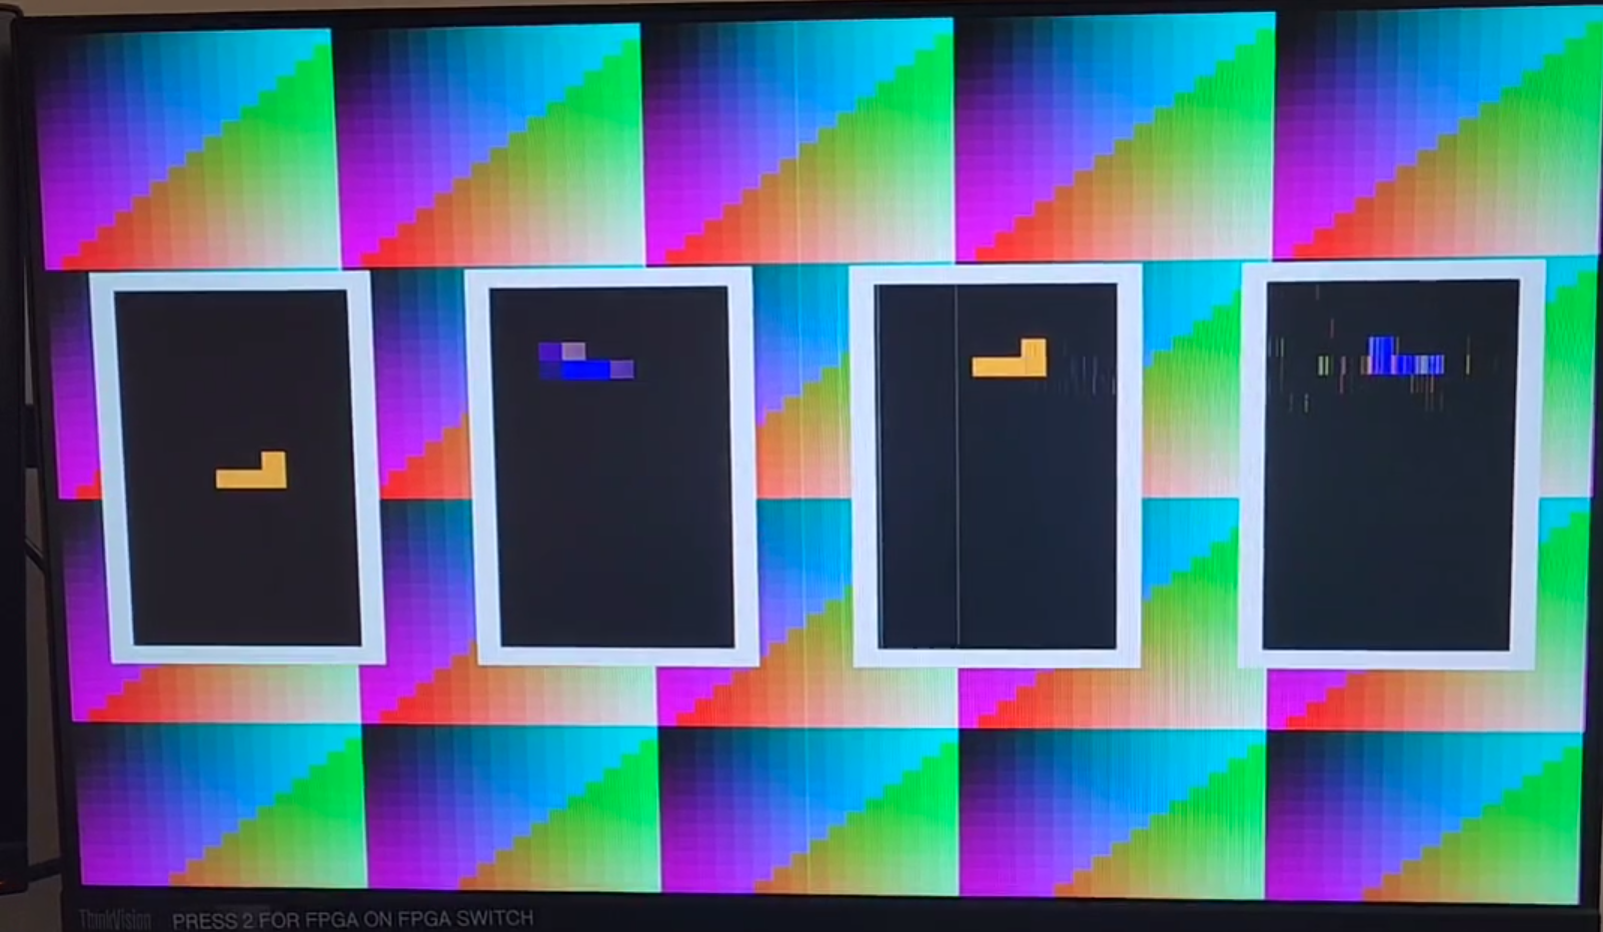
FPGA->VGA
Much easier

Slide 12

Success

Slide 13
Success
Functional basic game logic
Slow fall does not lock block: solved
Functional controller
Instant left right error: solved
Mostly functional VGA Display
Oscillations (will talk about later)

Slide 14
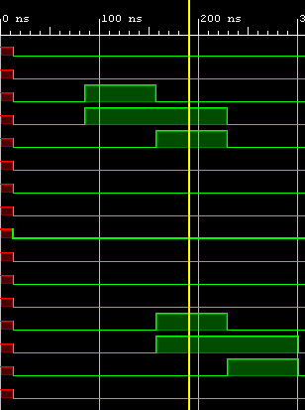
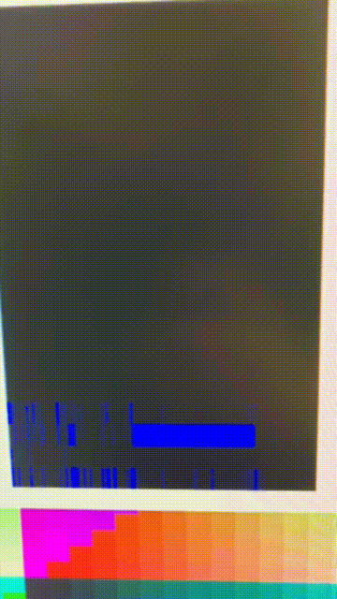
Failure (Oscillation)
How it’s supposed to be
Oscillation

Slide 15
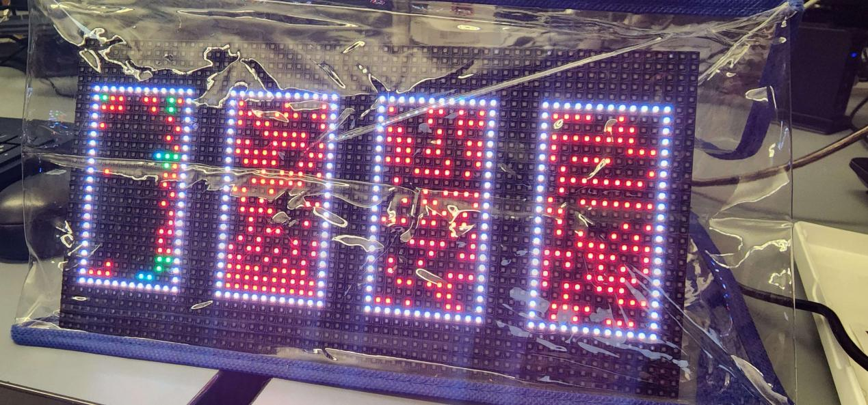
On the RGB Matrix
Leftmost panel: artifacts left behind the trail
Right panels: supposed to be unplugged -> all should be red but only some pixels are red

